Slide 1
Data Science
Session – 7
Date – 22nd May, 2022

Slide 2
R - Strings
Any value written within a pair of single quote or double quotes in R is treated as a string. Internally R stores every string within double quotes, even when you create them with single quote.
Rules Applied in String Construction
The quotes at the beginning and end of a string should be both double quotes or both single quote. They can not be mixed.
Double quotes can be inserted into a string starting and ending with single quote.
Single quote can be inserted into a string starting and ending with double quotes.
Double quotes can not be inserted into a string starting and ending with double quotes.
Single quote can not be inserted into a string starting and ending with single quote.

Slide 3
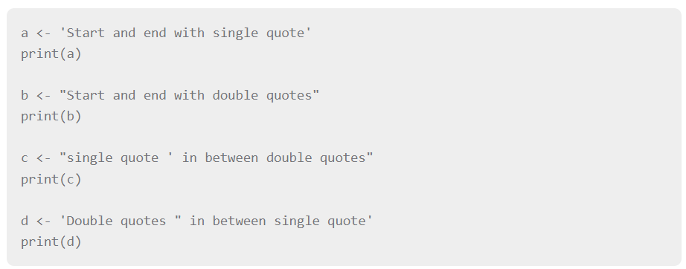
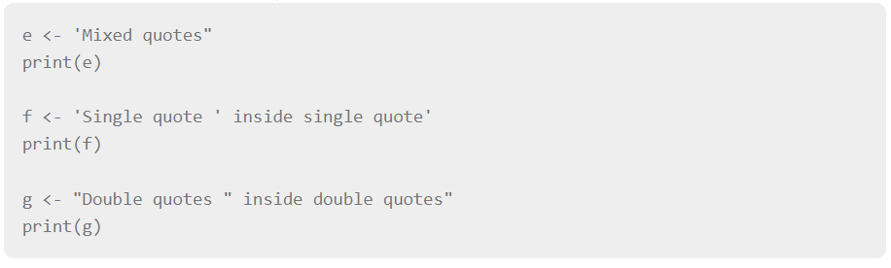
Examples of Valid Strings
Examples of Invalid Strings

Slide 4
String Manipulation
Concatenating Strings - paste() function
Many strings in R are combined using the paste() function. It can take any number of arguments to be combined together.
Syntax
The basic syntax for paste function is −
Following is the description of the parameters used −
... represents any number of arguments to be combined.
sep represents any separator between the arguments. It is optional.
collapse is used to eliminate the space in between two strings. But not the space within two words of one string.
paste(..., sep = " ", collapse = NULL)

Slide 5
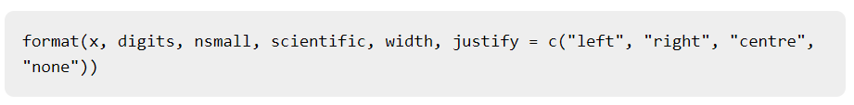
String Manipulation
Formatting numbers & strings - format() function
Numbers and strings can be formatted to a specific style using format() function.
Syntax
The basic syntax for format function is −
Following is the description of the parameters used −
x is the vector input.
digits is the total number of digits displayed.
nsmall is the minimum number of digits to the right of the decimal point.
scientific is set to TRUE to display scientific notation.
width indicates the minimum width to be displayed by padding blanks in the beginning.
justify is the display of the string to left, right or center.

Slide 6
String Manipulation
Counting number of characters in a string - nchar() function
This function counts the number of characters including spaces in a string.
Syntax
The basic syntax for nchar() function is −
Counting number of characters in a string - nchar() function
This function counts the number of characters including spaces in a string.
Syntax
The basic syntax for nchar() function is −

Slide 7
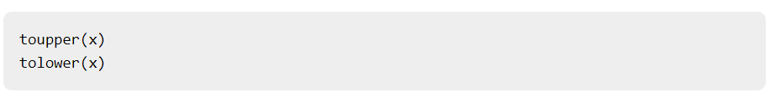
String Manipulation
Changing the case - toupper() & tolower() functions
These functions change the case of characters of a string.
Syntax
The basic syntax for toupper() & tolower() function is −
Following is the description of the parameters used −
x is the vector input.

Slide 8
String Manipulation
Extracting parts of a string - substring() function
This function extracts parts of a String.
Syntax
The basic syntax for substring() function is −
Following is the description of the parameters used −
x is the character vector input.
first is the position of the first character to be extracted.
last is the position of the last character to be extracted.

Slide 9
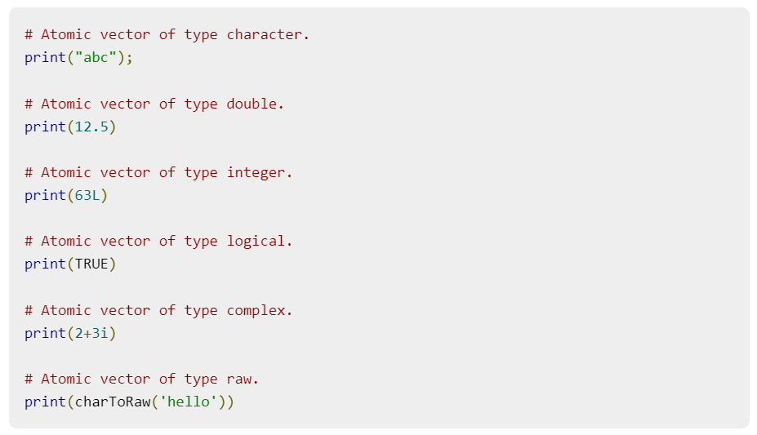
R - Vectors
Vectors are the most basic R data objects and there are six types of atomic vectors. They are logical, integer, double, complex, character and raw.
Vector Creation
Single Element Vector
Even when you write just one value in R, it becomes a vector of length 1 and belongs to one of the above vector types.

Slide 10
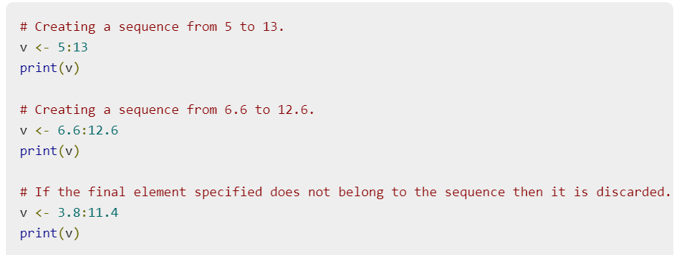
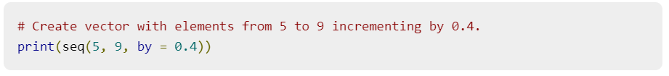
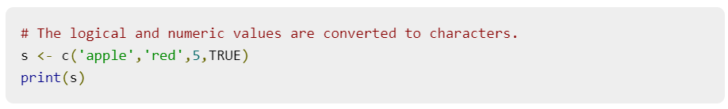
R - Vectors
Multiple Elements Vector
Using colon operator with numeric data
Using sequence (Seq.) operator
Using the c() function

Slide 11
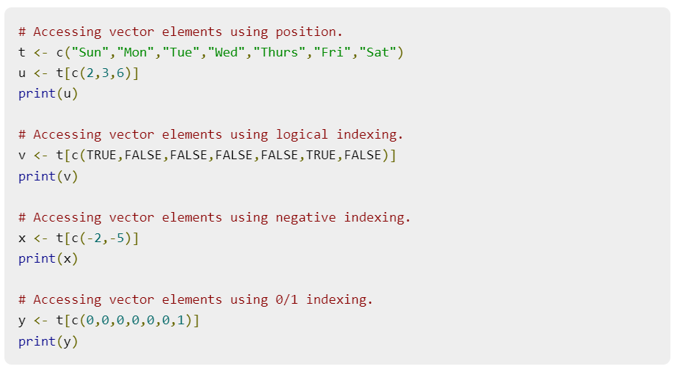
Accessing Vector Elements
Elements of a Vector are accessed using indexing. The [ ] brackets are used for indexing. Indexing starts with position 1. Giving a negative value in the index drops that element from result.TRUE, FALSE or 0 and 1 can also be used for indexing.

Slide 12
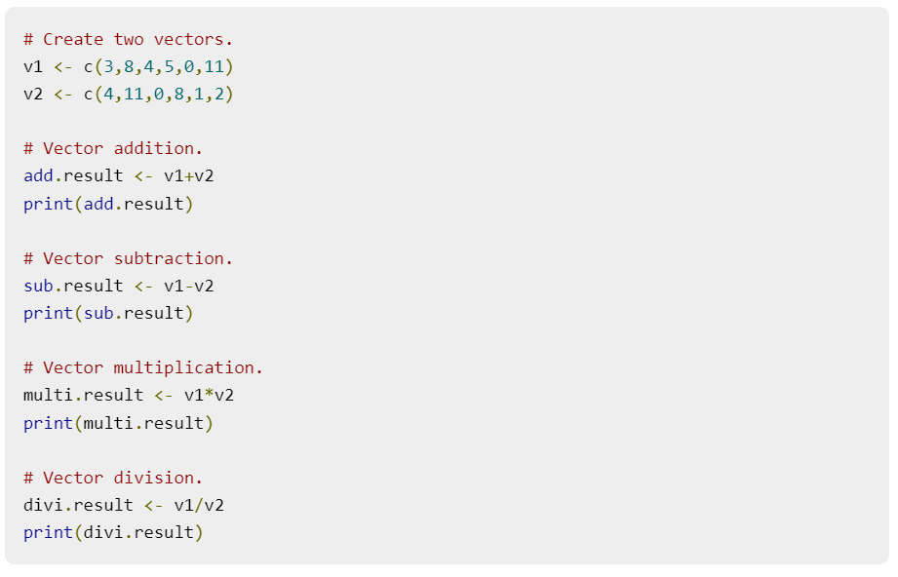
Vector Manipulation
Vector arithmetic
Two vectors of same length can be added, subtracted, multiplied or divided giving the result as a vector output.

Slide 13
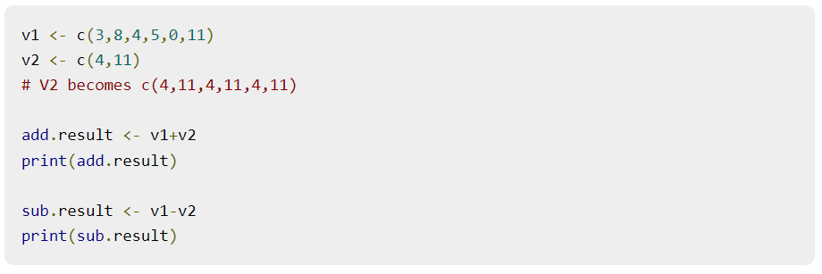
Vector Manipulation
Vector Element Recycling
If we apply arithmetic operations to two vectors of unequal length, then the elements of the shorter vector are recycled to complete the operations.

Slide 14
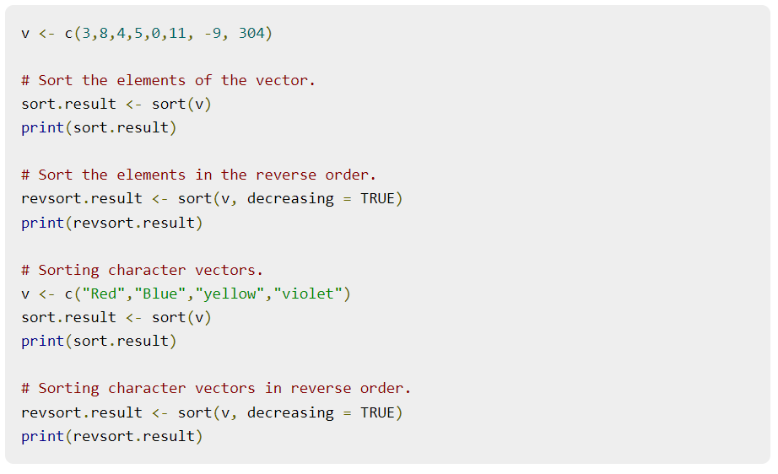
Vector Manipulation
Vector Element Sorting
Elements in a vector can be sorted using the sort() function.

Slide 15
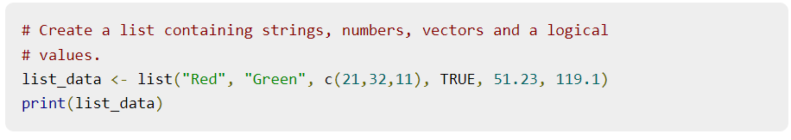
R - Lists
Lists are the R objects which contain elements of different types like − numbers, strings, vectors and another list inside it. A list can also contain a matrix or a function as its elements. List is created using list() function.
Creating a List
Following is an example to create a list containing strings, numbers, vectors and a logical values.

Slide 16
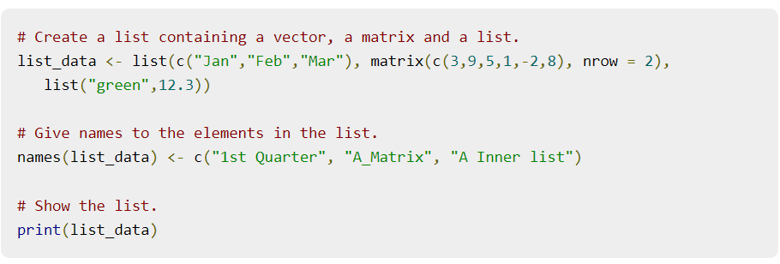
R - Lists
Naming List Elements
The list elements can be given names and they can be accessed using these names.

Slide 17
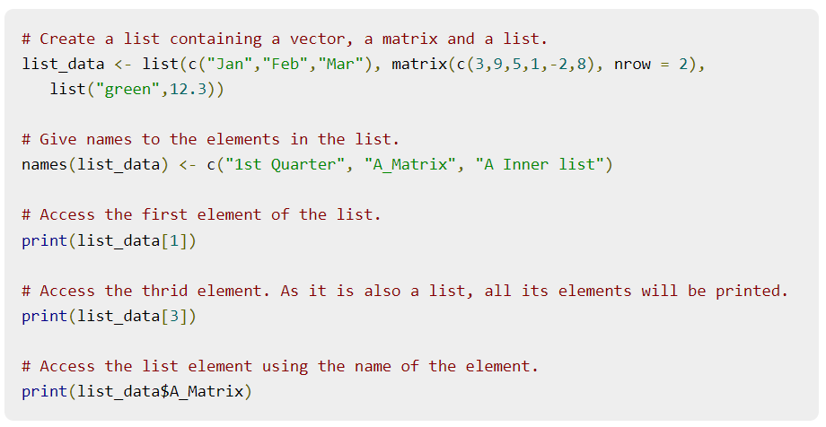
R - Lists
Accessing List Elements
Elements of the list can be accessed by the index of the element in the list. In case of named lists it can also be accessed using the names.
We continue to use the list in the above example −

Slide 18
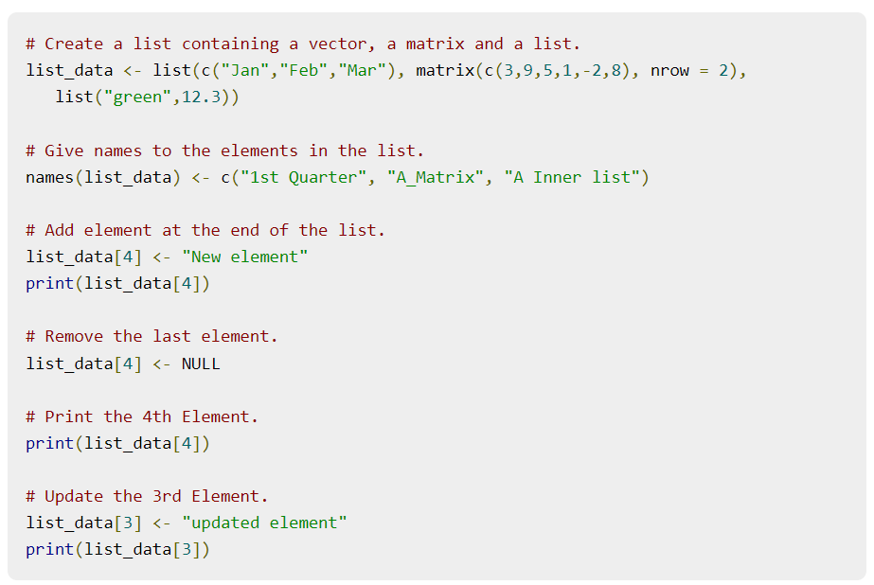
R - Lists
Manipulating List Elements
We can add, delete and update list elements as shown below. We can add and delete elements only at the end of a list. But we can update any element.

Slide 19
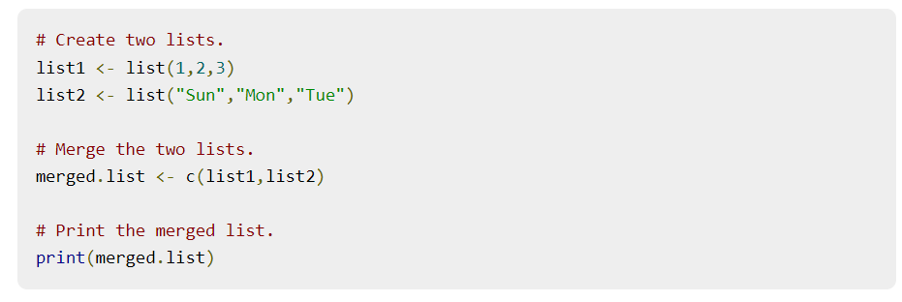
R - Lists
Merging Lists
You can merge many lists into one list by placing all the lists inside one list() function.

Slide 20
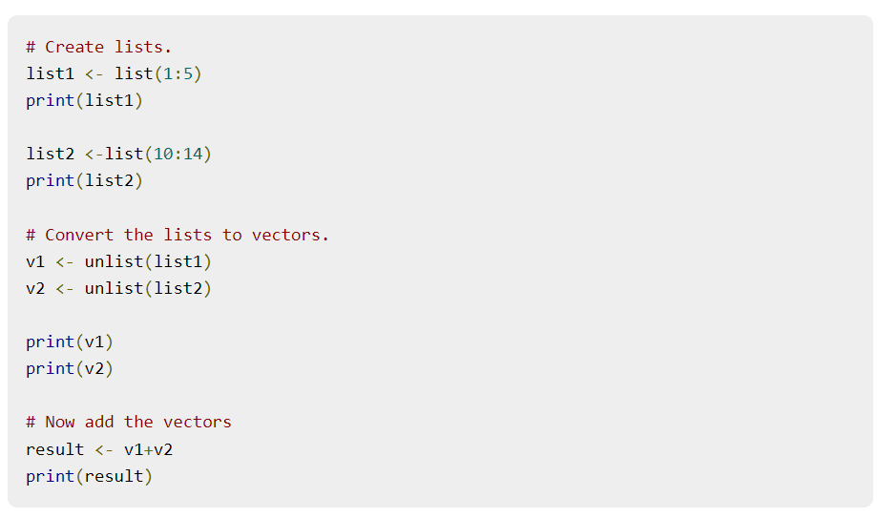
R - Lists
Converting List to Vector
A list can be converted to a vector so that the elements of the vector can be used for further manipulation. All the arithmetic operations on vectors can be applied after the list is converted into vectors. To do this conversion, we use the unlist() function. It takes the list as input and produces a vector.

Slide 21
R - Matrices
Matrices are the R objects in which the elements are arranged in a two-dimensional rectangular layout. They contain elements of the same atomic types. Though we can create a matrix containing only characters or only logical values, they are not of much use. We use matrices containing numeric elements to be used in mathematical calculations.
A Matrix is created using the matrix() function.
Syntax
The basic syntax for creating a matrix in R is −

Slide 22
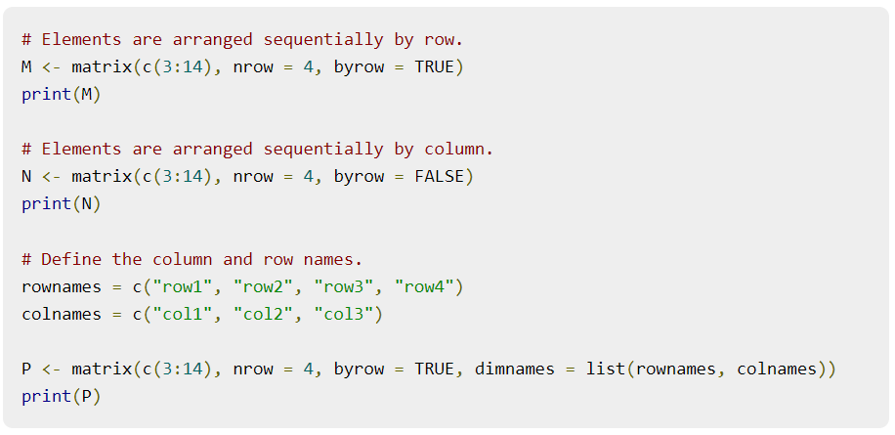
R - Matrices
Following is the description of the parameters used −
data is the input vector which becomes the data elements of the matrix.
nrow is the number of rows to be created.
ncol is the number of columns to be created.
byrow is a logical clue. If TRUE then the input vector elements are arranged by row.
dimname is the names assigned to the rows and columns.

Slide 23
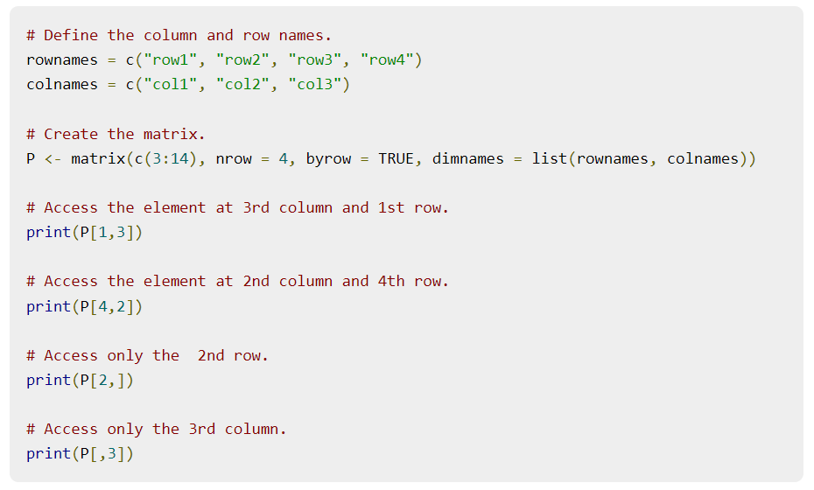
R - Matrices
Accessing Elements of a Matrix
Elements of a matrix can be accessed by using the column and row index of the element. We consider the matrix P above to find the specific elements below.

Slide 24
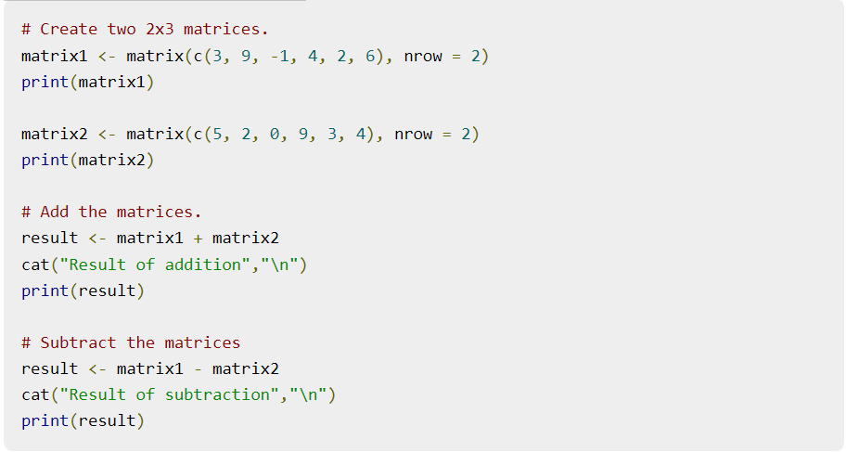
R - Matrices
Matrix Addition & Subtraction

Slide 25
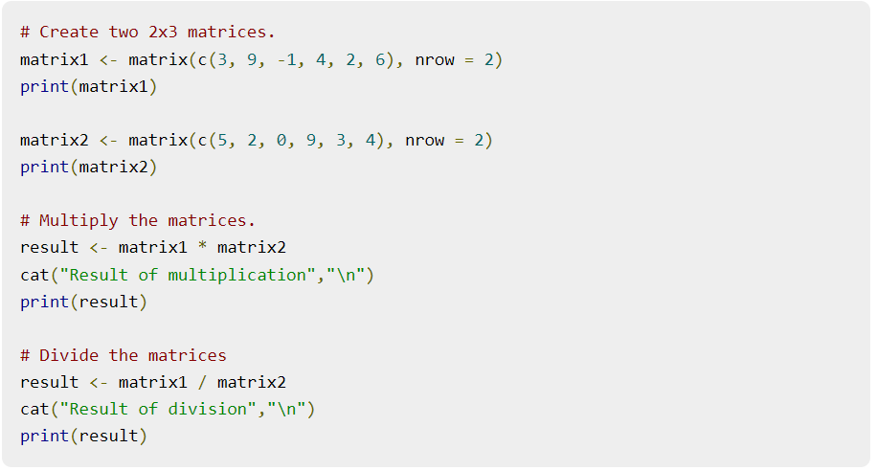
R - Matrices
Matrix Multiplication & Division

Slide 26
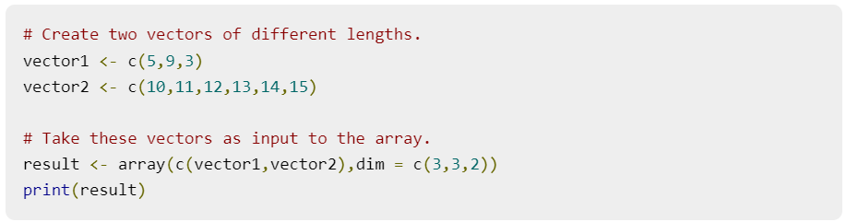
R - Arrays
Arrays are the R data objects which can store data in more than two dimensions. For example − If we create an array of dimension (2, 3, 4) then it creates 4 rectangular matrices each with 2 rows and 3 columns. Arrays can store only data type.
An array is created using the array() function. It takes vectors as input and uses the values in the dim parameter to create an array.
Example
The following example creates an array of two 3x3 matrices each with 3 rows and 3 columns.

Slide 27
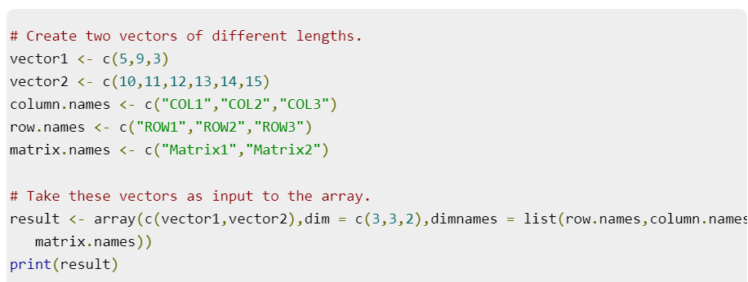
R - Arrays
Naming Columns and Rows
We can give names to the rows, columns and matrices in the array by using the dimnames parameter.

Slide 28
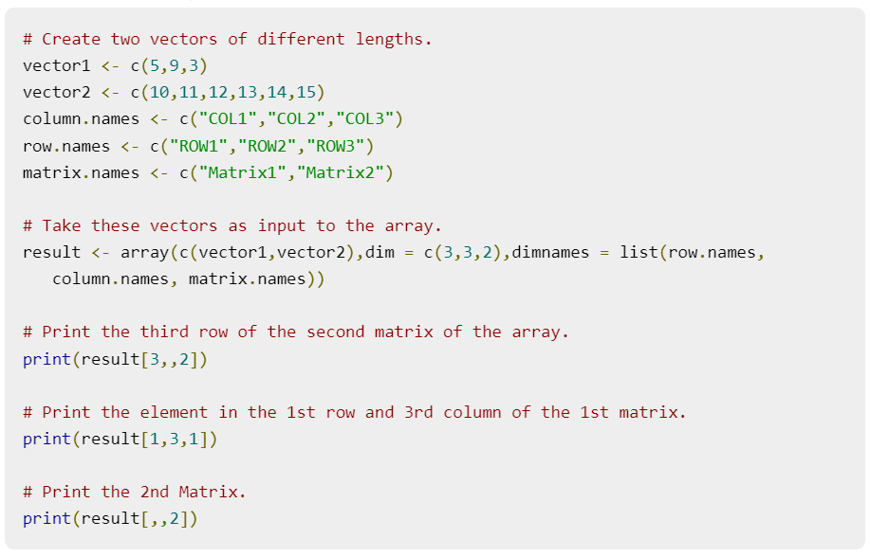
R - Arrays
Accessing Array Elements

Slide 29
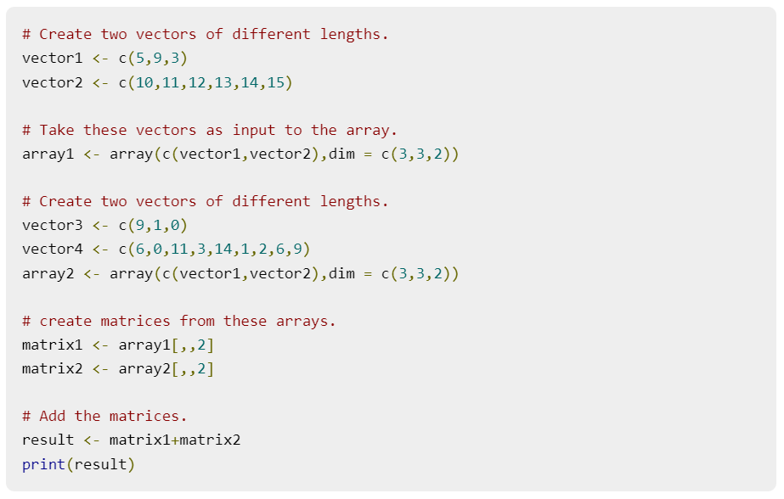
R - Arrays
Manipulating Array Elements
As array is made up matrices in multiple dimensions, the operations on elements of array are carried out by accessing elements of the matrices.

Slide 30
R - Arrays
Calculations Across Array Elements
We can do calculations across the elements in an array using the apply() function.
Syntax
Following is the description of the parameters used −
x is an array.
margin is the name of the data set used.
fun is the function to be applied across the elements of the array.

Slide 31
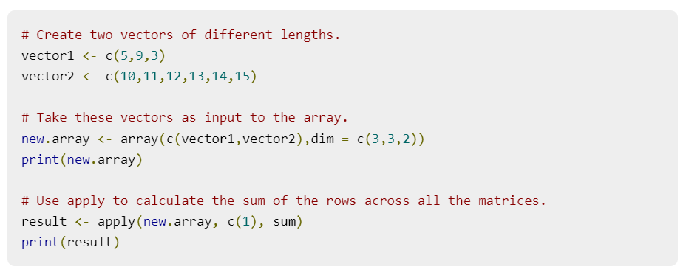
R - Arrays
Example
We use the apply() function below to calculate the sum of the elements in the rows of an array across all the matrices.

Slide 32
R - Factors
Factors are the data objects which are used to categorize the data and store it as levels. They can store both strings and integers. They are useful in the columns which have a limited number of unique values. Like "Male, "Female" and True, False etc. They are useful in data analysis for statistical modeling.
Factors are created using the factor () function by taking a vector as input.
# Create a vector as input. data <- c("East","West","East","North","North","East","West","West","West","East","North")
print(data) print(is.factor(data))
# Apply the factor function.
factor_data <- factor(data)
print(factor_data)
print(is.factor(factor_data))

Slide 33
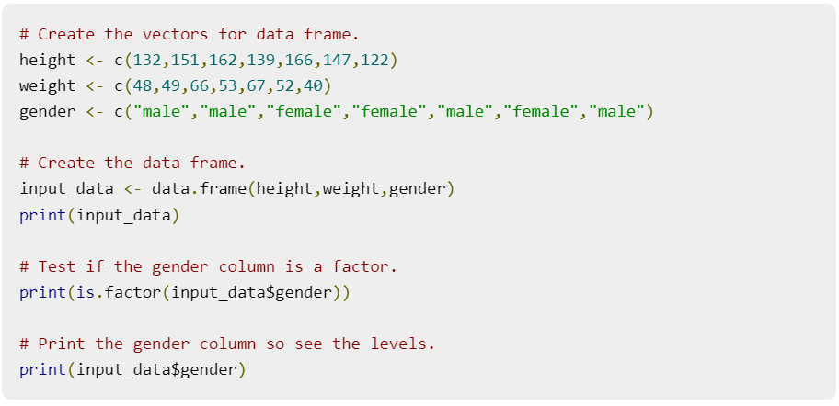
R - Factors
Factors in Data Frame
On creating any data frame with a column of text data, R treats the text column as categorical data and creates factors on it.

Slide 34
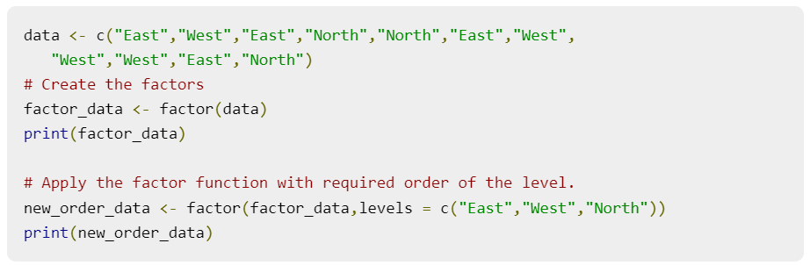
R - Factors
Changing the Order of Levels
The order of the levels in a factor can be changed by applying the factor function again with new order of the levels.

Slide 35
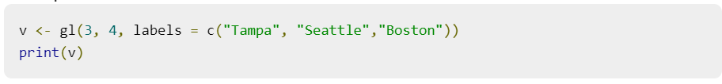
R - Factors
Generating Factor Levels
We can generate factor levels by using the gl() function. It takes two integers as input which indicates how many levels and how many times each level.
Syntax
Following is the description of the parameters used −
n is a integer giving the number of levels.
k is a integer giving the number of replications.
labels is a vector of labels for the resulting factor levels.
Example
gl(n, k, labels)

